Slide 1
Hidden Markov Models
MCB288
Spring 2022
Lecture 5

Slide 2
Finding features in a stream of data
Voice-recognition
Finding domains in protein sequences
Finding features (exons, introns, promoters, etc.) in genome sequences

Slide 3
Markov process
System can be in different states.
Transitions between states (in time, or along a DNA/protein sequence) occur probabilistically.
These transition probabilities don’t change (model is independent of where in time or sequence you start)
Andrei Andreyevich Markov*

Slide 4
Toy problem: the occasionally cheating casino
Player bets on whether coin comes up heads or tails.
Most of the time a ”fair” coin is used (heads and tails equally likely)
Occasionally, unbeknownst to the player, the casino swaps in a “biased” coin (more likely to be heads).
Casino switches back and forth at some rate
Can we, as players, figure out what is going on?

Slide 5
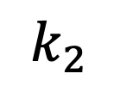
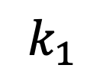
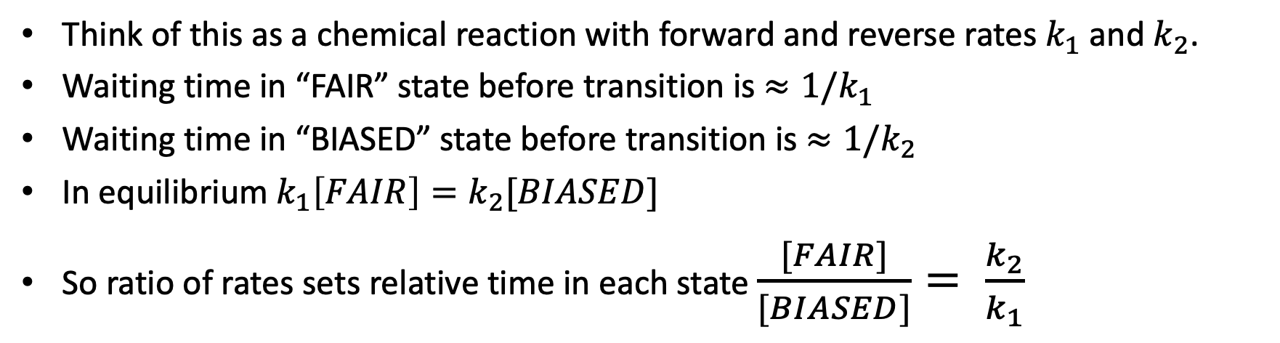
Modeling transitions between states
$$k_{1}$$
FAIR
BIASED
$$k_{2}$$
Think of this as a chemical reaction with forward and reverse rates $k_{1}$and $k_{2}$.
Waiting time in “FAIR” state before transition is ${≈1/k}_{1}$
Waiting time in “BIASED” state before transition is ${≈1/k}_{2}$
In equilibrium $k_{1}\left[FAIR\right]=k_{2}[BIASED]$
So ratio of rates sets relative time in each state $\frac{[FAIR]}{[BIASED]}= \frac{k_{2}}{k_{1}}$

Slide 6
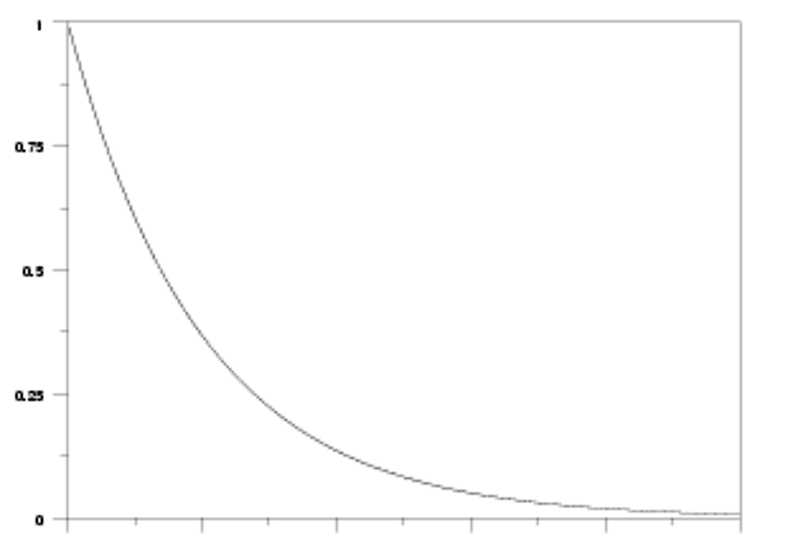
Geometric decay of dwell times
Probability of lasting this many time steps before making a transition
1/k₁
# time steps

Slide 7
Given state transition matrix, we can generate a (random) time series or sequence.
Simplest case: probability of state s at time t depends only on state of chain at previous time t-1 (no memory)
More general case adds memory of where the chain has been in the recent past: probability of s(t) depends on s(t-1) AND s(t-2) has memory two steps in the past.
Could imagine, in a DNA sequence, we might want to have a memory of where we are within a codon.

Slide 8
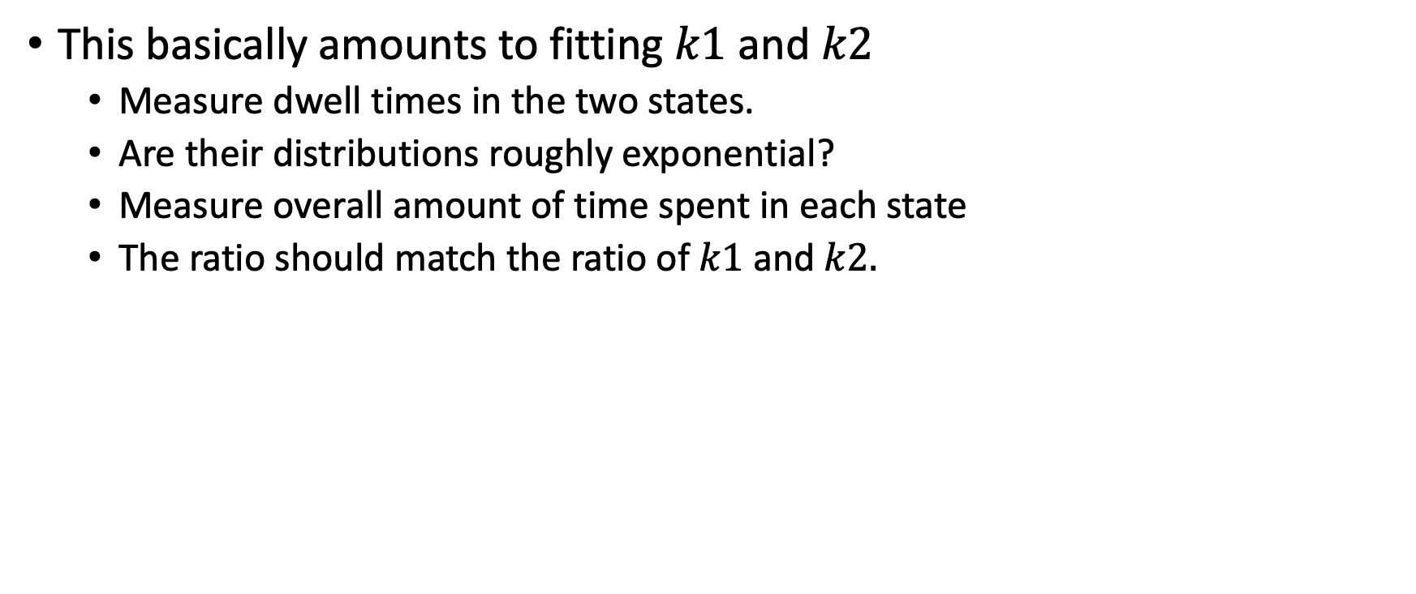
Conversely, if we are given a time series or sequence, we can try to find the Markov model that best “fits” it.
This basically amounts to fitting $k1$ and $k2$
Measure dwell times in the two states.
Are their distributions roughly exponential?
Measure overall amount of time spent in each state
The ratio should match the ratio of $k1$ and $k2.$

Slide 9
“Hidden” Markov model
We assume there is an underlying “state” that varies according to a probabilistic chain.
But we don’t get to see the state directly – it is “hidden”
Instead, the state “emits” an observable signal.
Properties of the emitted signal depends on the hidden state.
Example from text-to-voice
Hidden state is the phoneme (”th”, “long a”, etc.) obtained from text
Emitted state is the sound that the phoneme produces
Given a series of sounds, can we infer the underlying text.

Slide 10
Transitions between states
$$k_{1}$$
FAIR
BIASED
$$k_{2}$$
Think of this as a chemical reaction with forward and reverse rates $k_{1}$and $k_{2}$.
Waiting time in “FAIR” state before transition is ${≈1/k}_{1}$
Waiting time in “BIASED” state before transition is ${≈1/k}_{2}$
In equilibrium $k_{1}\left[FAIR\right]=k_{2}[BIASED]$
So ratio of rates sets relative time in each state $\frac{[FAIR]}{[BIASED]}= \frac{k_{2}}{k_{1}}$

Slide 11
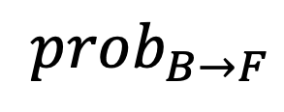
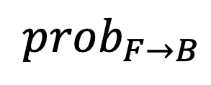
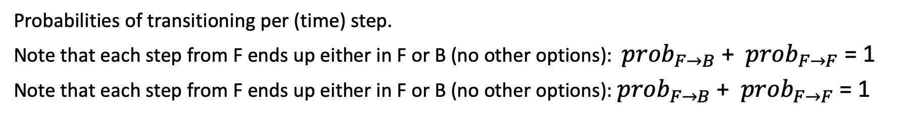
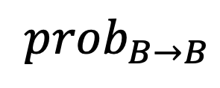
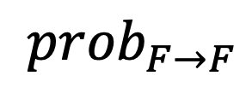
Probabilistic transitions between states
$${prob}_{F→B}$$
FAIR
BIASED
$${prob}_{F→F}$$
$${prob}_{B→B}$$
$${prob}_{B→F}$$
Probabilities of transitioning per (time) step.
Note that each step from F ends up either in F or B (no other options): ${prob}_{F→B}$ + ${prob}_{F→F}$ = 1
Note that each step from F ends up either in F or B (no other options): ${prob}_{F→B}$ + ${prob}_{F→F}$ = 1

Slide 12
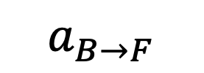
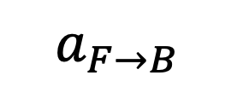
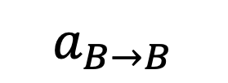
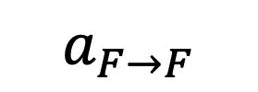
Probabilistic transitions between states
$$a_{F→B}$$
“Hidden” state
FAIR
BIASED
$$a_{F→F}$$
$$a_{B→B}$$
$$a_{B→F}$$
“Observed” (or “emitted”) state
Heads: b(H|Fair)=0.5
Tails: b(T|Fair)=0.5
Heads: b(H|Bias)=0.75
Tails: b(T|Bias)=0.25
Emission probabilities from each state add up to 1 (something always gets emitted!)
But the emission probabilities depend on hidden state

Slide 13
This framework is very general
Need to specify
hidden states and the transition probabilities (rates) between them (a’s)
Emission probabilities for each hidden state (b’s)
Common application
Specify the underlying model (hidden states, possible emitted observables)
Learn the probabilities from data (supervised or unsupervised)

Slide 14
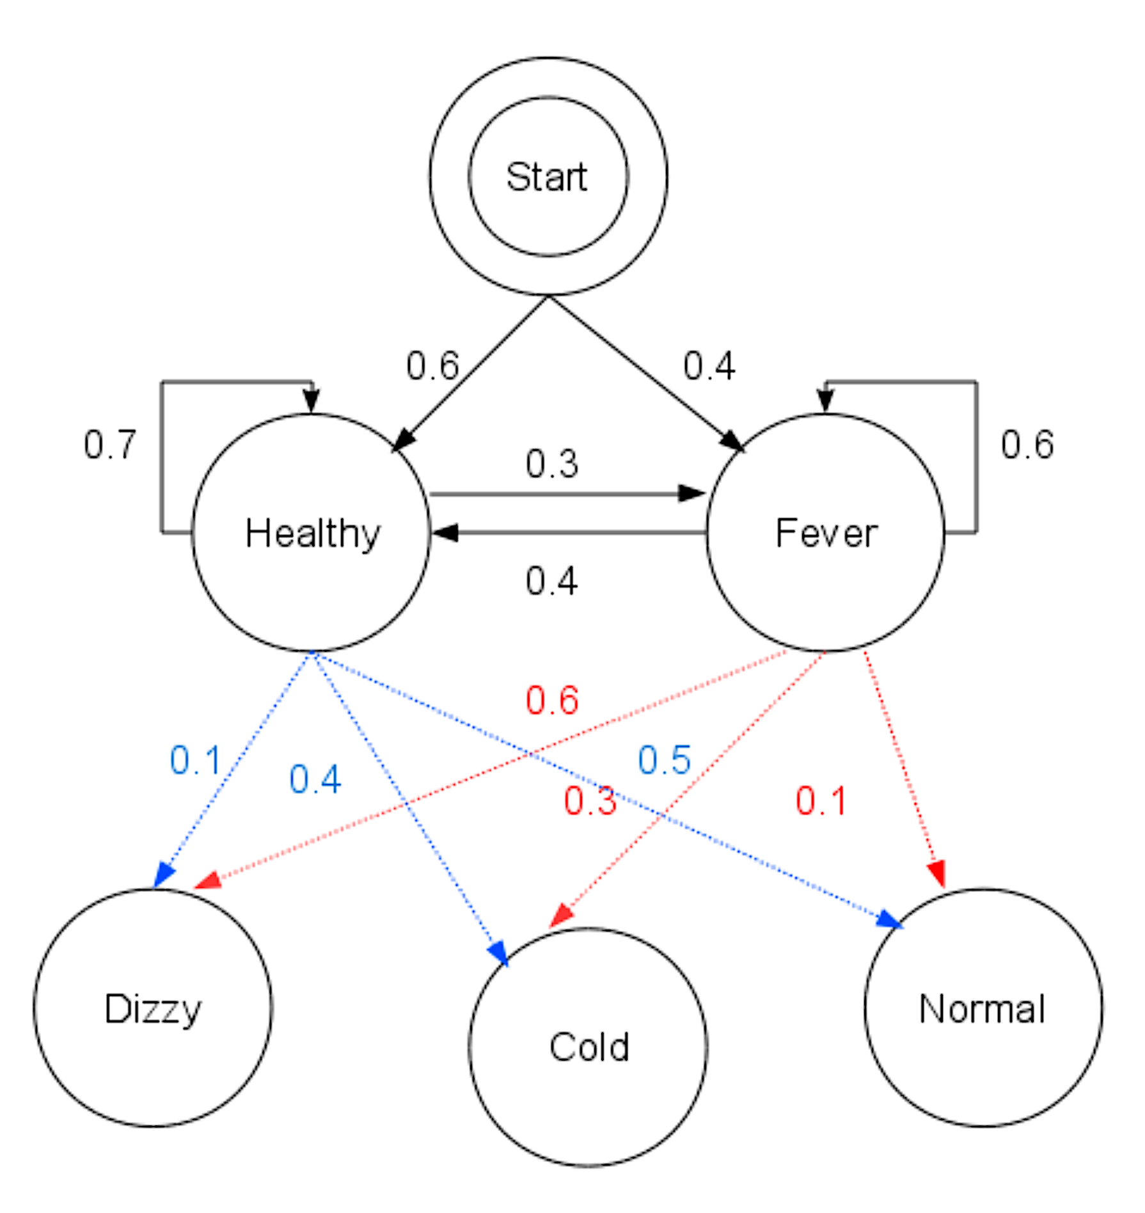
Example from Wikipedia “Viterbi algorithm”
Consider a village where all villagers are either healthy or have a fever and only the village doctor can determine whether each has a fever. The doctor diagnoses fever by asking patients how they feel. The villagers may only answer that they feel normal, dizzy, or cold.
The doctor believes that the health condition of his patients operates as a discrete Markov chain. There are two states, "Healthy" and "Fever", but the doctor cannot observe them directly; they are hidden from him. On each day, there is a certain chance that the patient will tell the doctor he is "normal", "cold", or "dizzy", depending on their health condition.
The observations (normal, cold, dizzy) along with a hidden state (healthy, fever) form a hidden Markov model (HMM), and can be represented as follows in the Python programming language:
obs = ("normal", "cold", "dizzy")
states = ("Healthy", "Fever")
start_p = {"Healthy": 0.6, "Fever": 0.4}
trans_p = { "Healthy": {"Healthy": 0.7, "Fever": 0.3},
"Fever": {"Healthy": 0.4, "Fever": 0.6}, }
emit_p = { "Healthy": {"normal": 0.5, "cold": 0.4, "dizzy": 0.1},
"Fever": {"normal": 0.1, "cold": 0.3, "dizzy": 0.6}, }

Slide 15
What we want to know:
Given an HMM model (the states and the a’s and b’s) and a stream of emitted signals, what is the most likely series of hidden states?
Formulation:
Write out the overall likelihood of the entire data stream in terms of the a’s and b’s. This is not difficult, but a bit tedious.
Can do it iteratively:
Likelihood(stream up to and including n-th emitted character) = simple expression in terms of
Likelihood(stream up to and including (n-1)-th emitted character and
the transition and emission probabilities going from (n-1) to n.
There is an efficient algorithm (the “Viterbi algorithm”) to find series of hidden states that maximizes this probability.

Slide 16

Given a specified HMM (a’s and b’s), and the emitted series, what is the most likely series of hidden states?
“The Viterbi algorithm is a dynamic programming algorithm for finding the most likely sequence of hidden states—called the Viterbi path—that results in a sequence of observed events, especially in the context of Markov information sources and hidden Markov models (HMM).”
https://viterbischool.usc.edu/about-andrew-viterbi/
(Andrew Viterbi also founded QualComm)

Slide 17
Vitterbi “path” through hidden state space
FFFFFFFFFFFFFFFFFFFFFFFFFFFFFFFFFFFFFFFFFFFFFFFFBBBBBBBBBBBBBBBBBBBBBBBBBBBBBBBBBBBBBBBBBBBBBBBB
Very efficient algorithm, time proportional to length of sequence
We will see the code that implements it, but will not go through the derivation (see Wikipedia!)

Slide 18
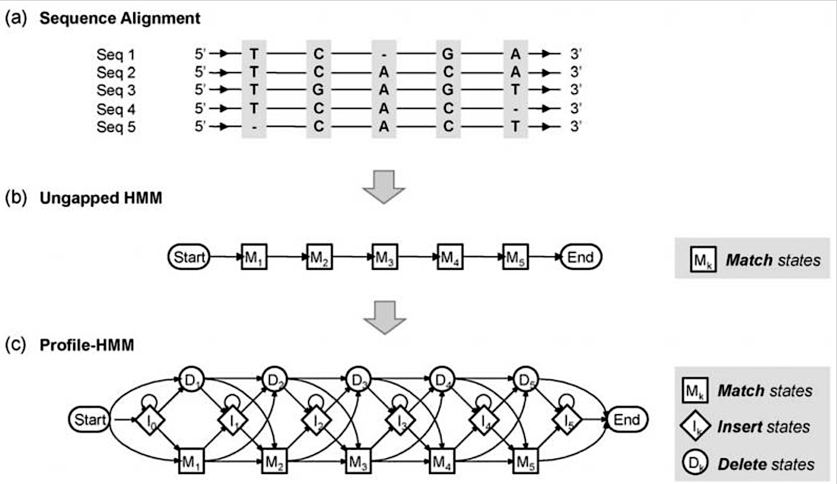
Yoon, “Hidden Markov Models and their Applications in Biological Sequence Analysis” Current Genomics (2009)
https://www.ncbi.nlm.nih.gov/pmc/articles/PMC2766791/
If you’ve ever used Sean Eddy et al’s PFAM, you’ve used a “profile” HMM.
State M1 emits T with high probability, other letters and “gap” with low probability.
…
State M4 emits C with high probability ~0.6 and G with probability ~0.4.
What is the probability that a new sequence fits this profile?
Score = -log(probability)
(log makes it proportional to sequence length)

Slide 19
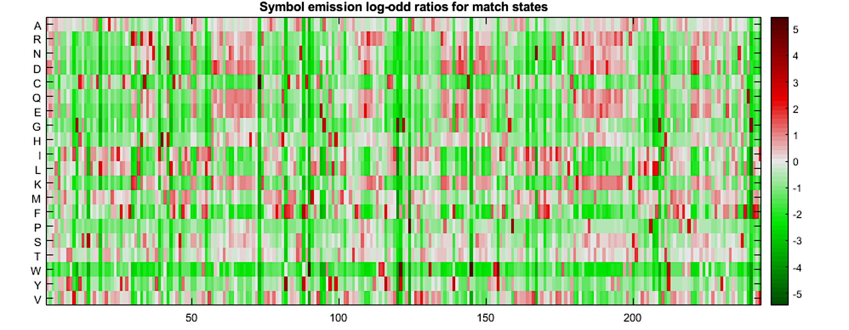
PFAM PF00002 = 7 transmembrane receptor
Log odds ratios as we discussed last time: what are the odds that a particular amino acid is present at each position?
Example from https://www.mathworks.com/help/bioinfo/ug/using-hmms-for-profile-analysis-of-a-protein-family.html

Slide 20
Log(likelihood) = sum of “match or mismatch” scores
Likelihood = p(S1 | M1)*p(S2 | M2)* p(S3 | M3) * ….
Since the p’s are less than 1, this gets very small very fast.
Log (likelihood) = s(S1|M1) + s(S2|M2) + s(S3|M3) +…
Where “score” s(S1|M1) = log odds ratio of finding S1 at site 1 vs alternatives.
Favorable odds ratio > 1 => score > 0
Poor odds ratio < 1 => score is negative (penalty)

Slide 21
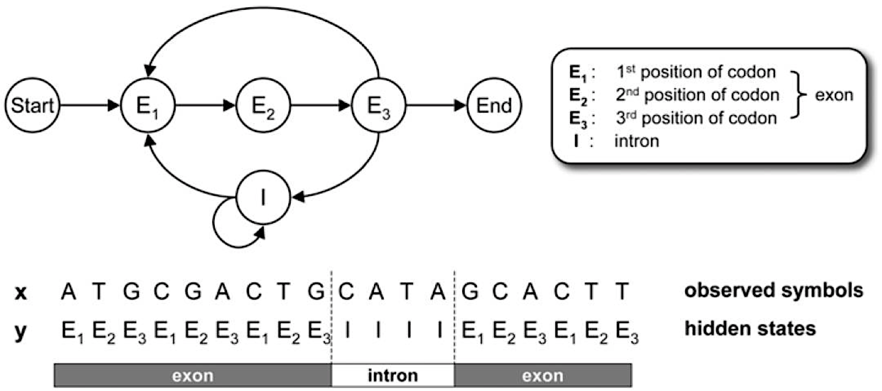
Given a DNA sequence, find the reading frame and exon-intron boundaries

Slide 22
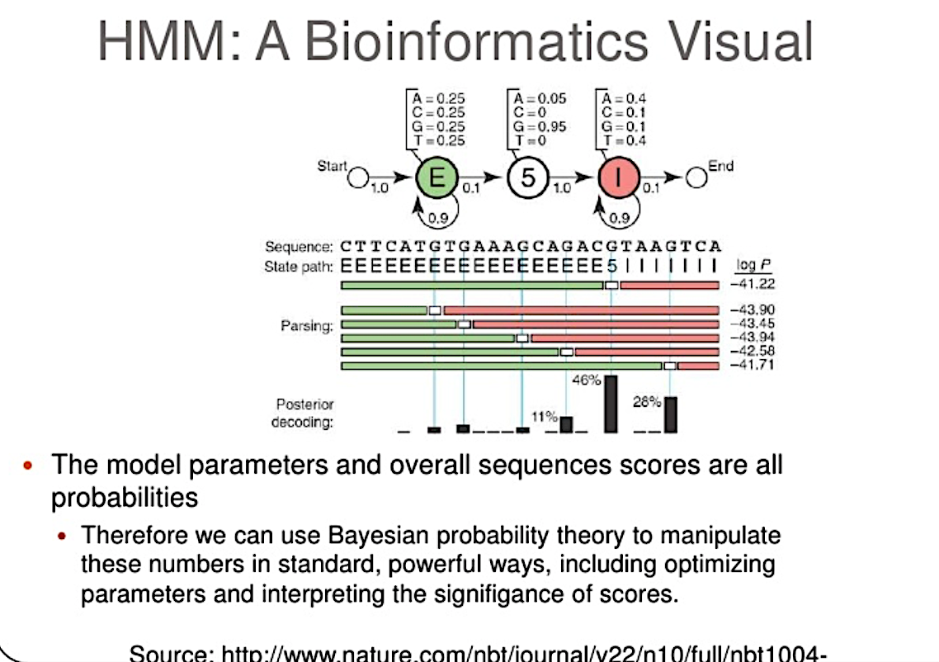
Imagine trying out some guess at the series of hidden states. (could be a random guess, could be based on something else, e.g., guess “Exon” if the sequence has an alignment to a known peptide, “Intron” otherwise.
Then imagine trying variations on your guess, by moving boundaries between E and I. You always incur a “cost” of switching hidden state. What matters is optimizing “fit” to exon or intron. It may cost you, however to make the exon longer or shorter than 1/k.
Algorithm balances all of this automatically

Slide 23
Training a model.
So far, we are given a model (set of a’s and b’s), and a sequence of emitted states, and want to
extract the “hidden” state, or
evaluate the log(likelihood) that a new sequence was “emitted” by the profile model
We produce the model itself (a’s and b’s) ”by hand” (e.g., estimating dwell times, or from multiple sequence alignments).
Alternative: an iterative approach that continually tweaks the a’s and b’s trying to maximize log likelihood.
This is considerably more expensive computationally, but there’s an algorithm for that (Baum-Welch).

